Slide 1
Object-oriented Design Patterns
ePortfolio – TINF14B2
DHBW Karlsruhe
Sebastian Schmidl - 2256419

Slide 2
Outline
What is a Design Pattern?
Elements of Design Patterns
Why we should use Design Patterns
Criticism
Organizing Design Patterns
Important Design Patterns (Examples)
The ActiveObject Pattern
Description
Hands-On

Slide 3

What is a Design Pattern?
“Each pattern describes a problem which occurs over and over again in our environment, and then describes the core of the solution to that problem, in such a way that you can use this solution a million times over, without ever doing it the same way twice”¹
1: Christopher Alexander, Sara Ishikawa, Murray Silverstein, Max Jacobson, Ingrid Fiksdahl-King, and Shlomo Angel. A Pattern Language. Oxford University Press, NewYork, 1977.

Slide 4
What is a Design Pattern?
Elements of Design Patterns
Name
Vocabulary to talk about
Problem
When to apply the pattern
Solution
Consequences
Abstract description of a design problem
Results
Trade-offs
Language / Implementation issues
Problem description
How can the problem be solved

Slide 5
Why we should use Design Patterns
Minimize redesign through reusing solutions
Make design more flexible and elegant
Make proven techniques more accessible to new/other developers
Improve documentation and maintenance => common language and vocabulary

Slide 6
Criticism
Sign for missing features in a programming language
Inappropriate use increases complexity
“once you begin to learn patterns you tend to over use them”

Slide 7
Organizing Patterns
Scope
Factory Method
Adapter
Interpreter, Template Method
Class
Abstract Factory, Builder, Prototype, Singleton
Adapter, Bridge, Composite, Decorator, Facade, lywight, Proxy
Chain of Responsi-bility, Command, Iterator, Mediator, Memento, Observer, State, Strategy, Visitor
Object
Creational
Structural
Behavioral
Purpose
Notes:
Creational Patterns These design patterns provide a way to create objects while hiding the creation logic, rather than instantiating objects directly using new opreator. This gives program more flexibility in deciding which objects need to be created for a given use case.
Structural Patterns These design patterns concern class and object composition. Concept of inheritance is used to compose interfaces and define ways to compose objects to obtain new functionalities.
Behavioral Patterns These design patterns are specifically concerned with communication between objects.

Slide 8
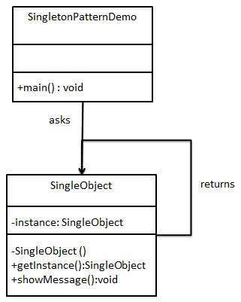
Important Design Patterns (for Java)
Singleton
Guarantees that there is only one instance of a particular object
Be careful -> do not use it when in doubt

Slide 9
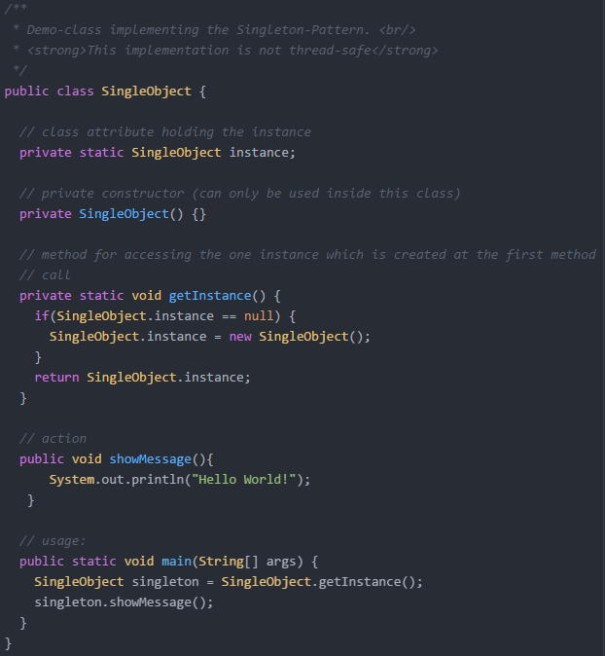

Slide 10
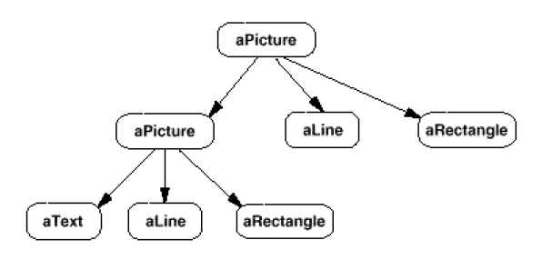
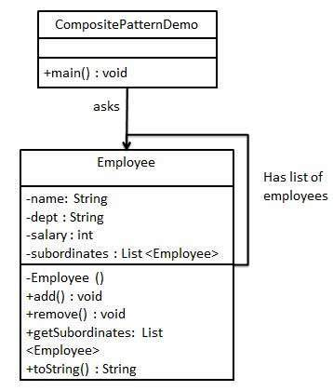
Important Design Patterns (for Java)
Composite
Represent a tree structure
User treats individual objects and compositions uniformly
Example: Graphic components that are formed by other components also formed by components.

Slide 11
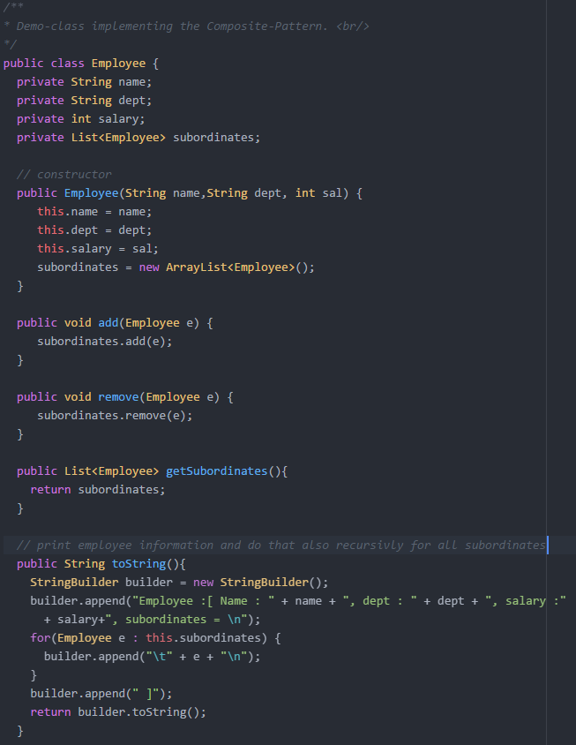
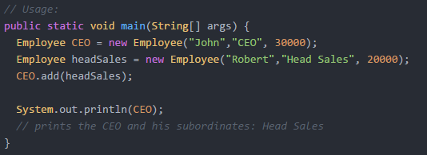

Slide 12
Important Design Patterns (for Java)
Decorator / Wrapper
Attach additional responsibilities to an object dynamically (not to the whole class)
Alternative to subclassing
Allows nesting, because of recursion and transparency

Slide 13
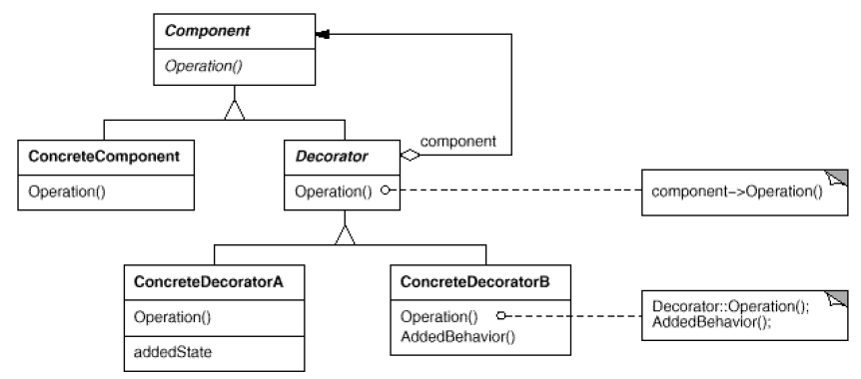
Important Design Patterns (for Java)

Slide 14

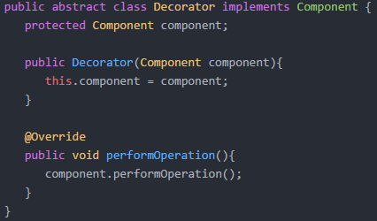
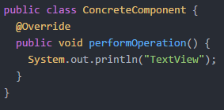
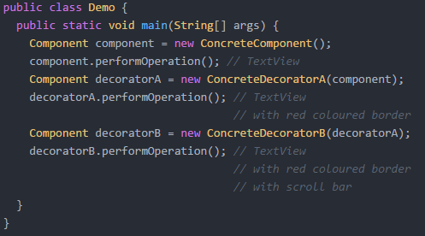
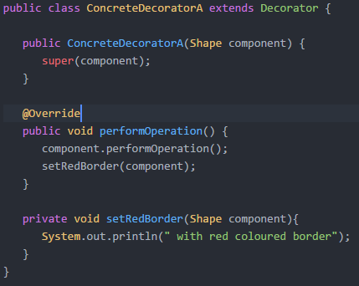
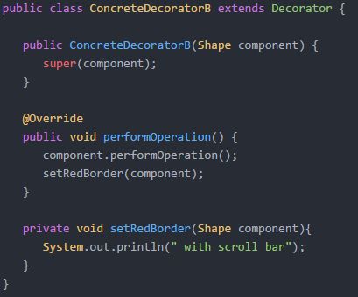

Slide 15
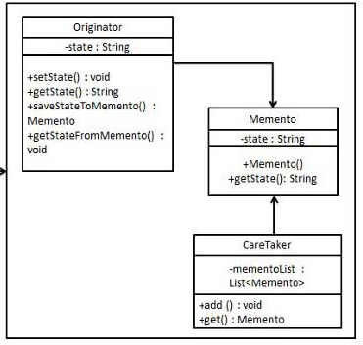
Important Design Patterns (for Java)
Memento / Token
Capture an object’s internal state to allow restoring this state
Therefore it has to be externalized without violating encapsulation
Used for: Undo mechanisms

Slide 16
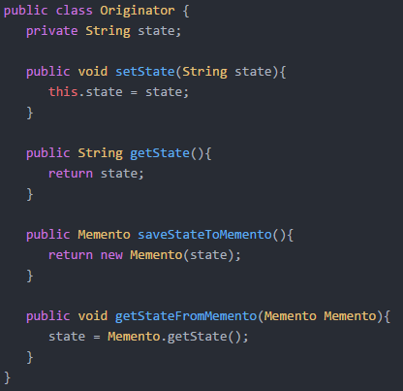
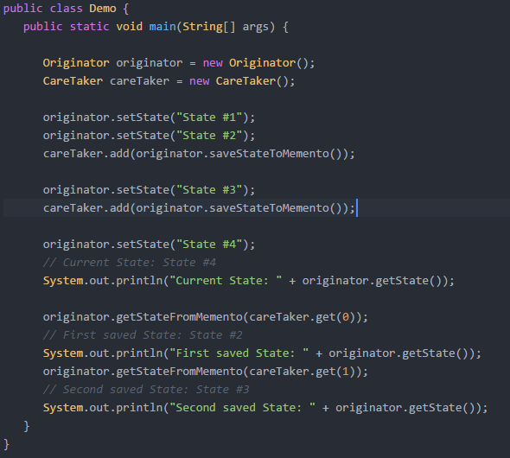
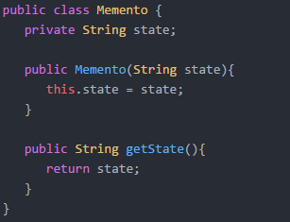
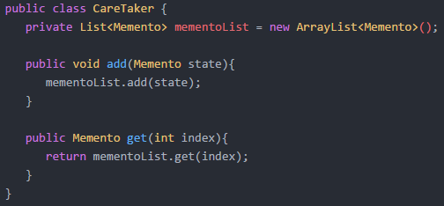

Slide 17
Patterns for Concurrent and Networked Objects
Challenges for networked applications developers:
Static and dynamic component configuration
Event handling and dispatching
Synchronization
Concurrency
Interprocess communication (IPC) & network protocols
Primary and secondary storage management / caching
Service Access and Configuration Patterns
Event Handling Patterns
Synchronization Patterns
Concurrency Patterns

Slide 18
Patterns for Concurrent and Networked Objects
Service Access and Configuration Patterns
Event Handling Patterns
Synchronization Patterns
Concurrency Patterns
Wrapper Facade
Interceptor
Component Configurator
Extension Interface
Reactor
Proactor
Asynchronous Completion Token
Acceptor-Connector
Scoped Locking
Strategized Locking
Thread-Safe Interface
Double-Checked Locking Optimization
Active Object
Monitor Object
Half-Sync/Half-Async
Leader/Followers
Thread-Specific Storage

Slide 19
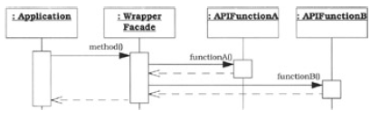
Important Patterns
Service Access and Configuration Patterns
Wrapper Facade
Encapsulate low-level functions within OO class interfaces
Networking applications are often written using low-level functions. This leads to:
Non-robust programs
Lack of portability
High maintenance effort

Slide 20
Important Patterns
Event Handling Patterns
Reactor / Dispatcher
Handles concurrently arriving events in an synchronous way
Avoids the creation of a thread for each incoming request => application only needs one thread for handling concurrently arriving events
Separation of demultiplexing and handling of the events
Simple integration of new or improved services/handlers
Java AWT listener concept is similar to the Reactor pattern
Proactor is an asynchronous variant of the Reactor

Slide 21
Important Patterns
Synchronization Patterns
Double-Checked Locking Optimization
Applicable if a critical section of code must acquire locks in a thread-safe manner just once during program execution
It reduces locking and synchronization overhead
Best example: Singleton in a multi-threaded environment
Can be UNSAFE in some language/hardware combinations

Slide 23
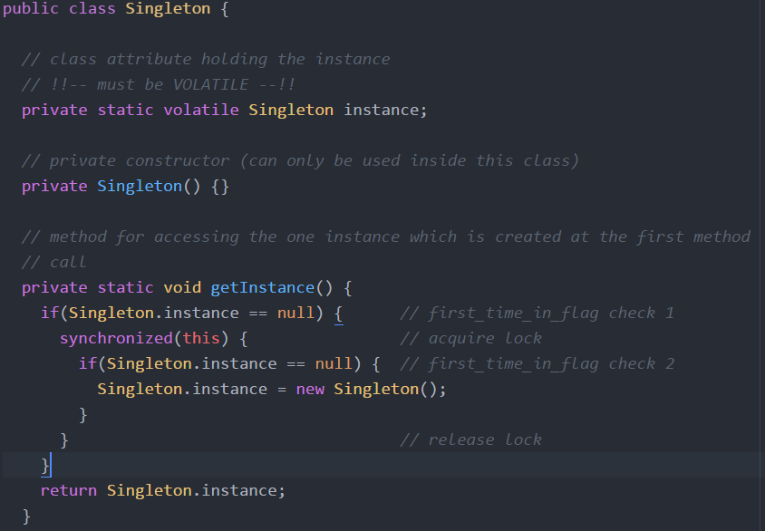

Slide 24
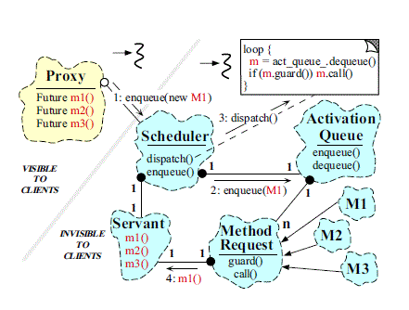
Important Patterns
Concurrency Patterns
Active Object / Concurrent Object
Decouples method execution from method invocation
Enhances concurrency and simplifies synchronized access to an object in its own thread of control

Slide 25
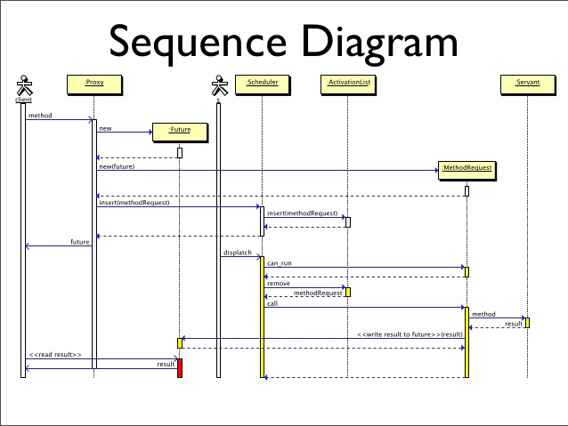

Slide 26
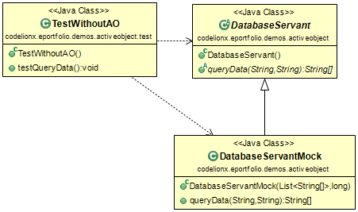
Active Object Pattern
Simple demo application:
Database mockup
Client can query some data with queryData()
Accessing the „database“ takes a lot of time (~5s)
We want to do multiple queries
Client

Slide 27
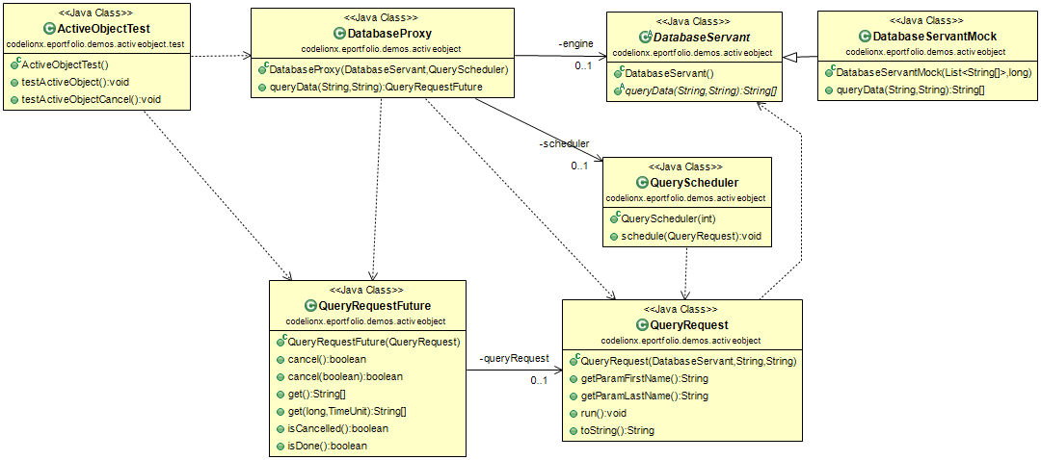
Active Object Pattern
Visible for Client
Hidden
Client

Slide 28
Thank you for your Attention!

Slide 29
Sources
Christopher Alexander, Sara Ishikawa, MurraySilverstein, Max Jacobson, Ingrid Fiksdahl-King, and Shlomo Angel.A Pattern Language. Oxford University Press, NewYork, 1977.
http://www.codeguru.com/images/article/18981/Classes.gif
http://www.patterns-kompakt.de/patterns/activeobject.html
All others are in the file: Presentation/Outline.docx

